Slide 1
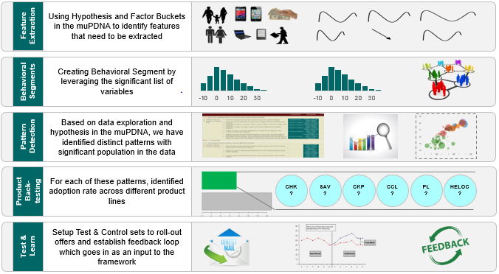

A framework helped recommend product/ services to customers by leveraging their need states with potential impact of ~$100MM
Product Recommendation case study summary
Business problem
Impact
The Customer Experience team uses a 'Next Best Offer' (NBO) model for its retail banking customers, which recommends products based on customer profiles and their offline spend
The client wanted to leverage the online journey of customers along with their offline behavior and attributes to provide more accurate recommendations
There is a need to recommend products/services by creating a 360 degree view of the customer
Client was able to realize ~$100MM impact due to the correct targeting of customers
These recommendations can result in up to 3x incremental adoption rate (subject to conversion rates)
Approach
Relevance
The Global Customer Experience team leveraged the model across geographies to push relevant products based on the need state of the customer

Slide 2


The client wanted to recommend product/ services to its customers by segmenting them & understanding their need states
Product Recommendation – Problem Background
Current State
Objectives
Offline Spend
Customer Profile
Identify the needs states of the customer
NBO Model
Prioritize the right products/services to recommend
The customer experience team uses a 'Next Best Offer' (NBO) model for its retail banking customers, which recommends products based on customer profiles and their offline spend
They wanted to leverage the online journey of customers along with their offline behavior and attributes
Identify the right manner of recommending these products/services

Slide 3

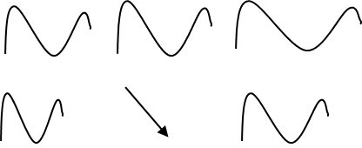

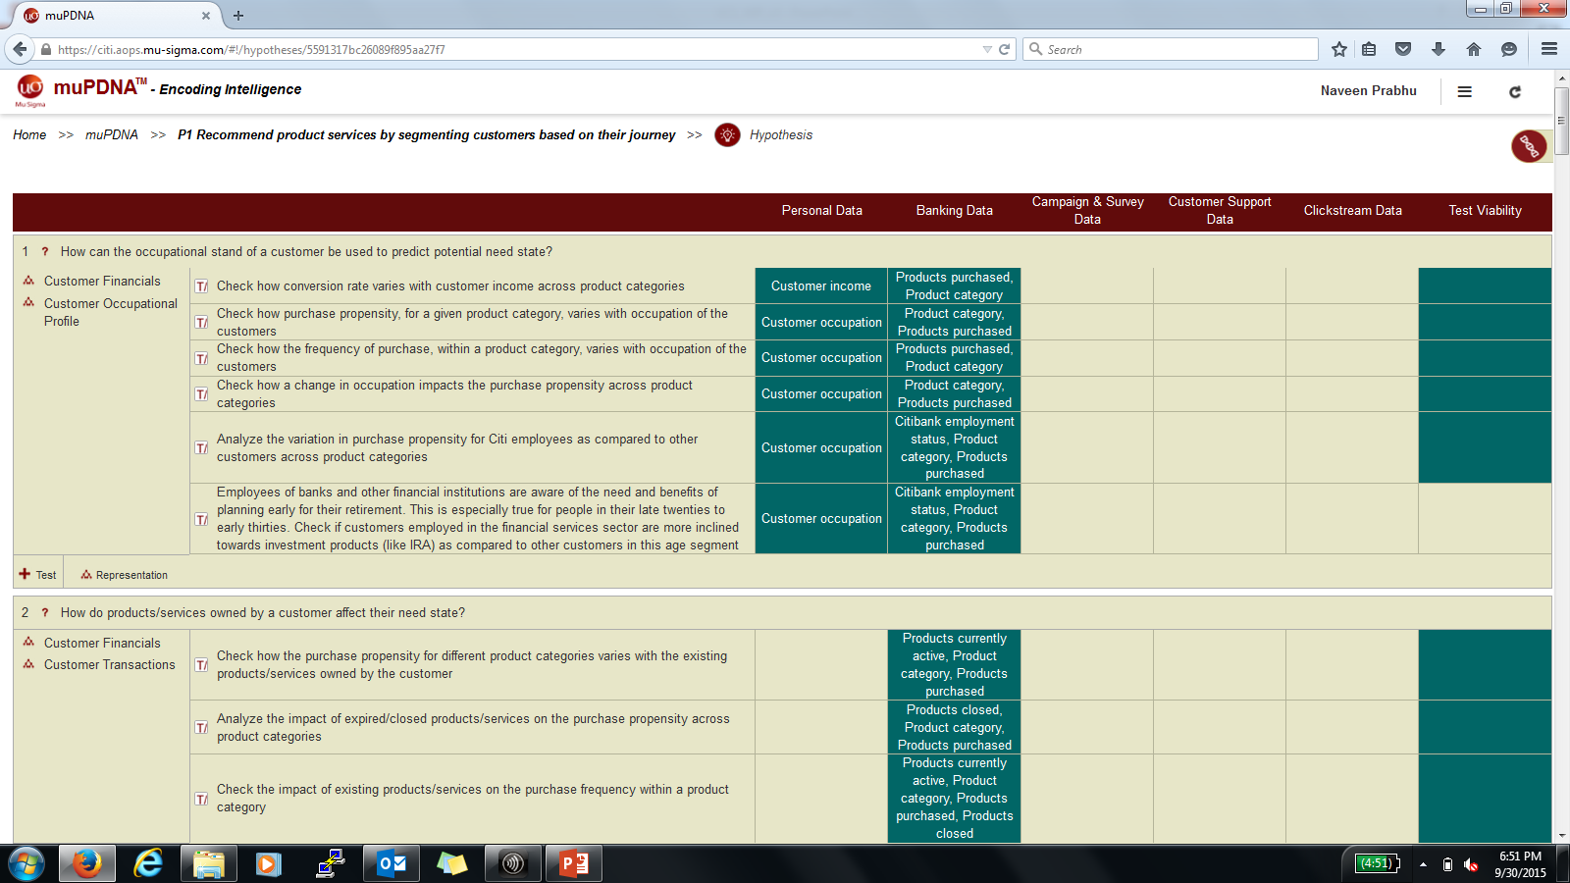

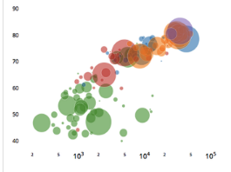
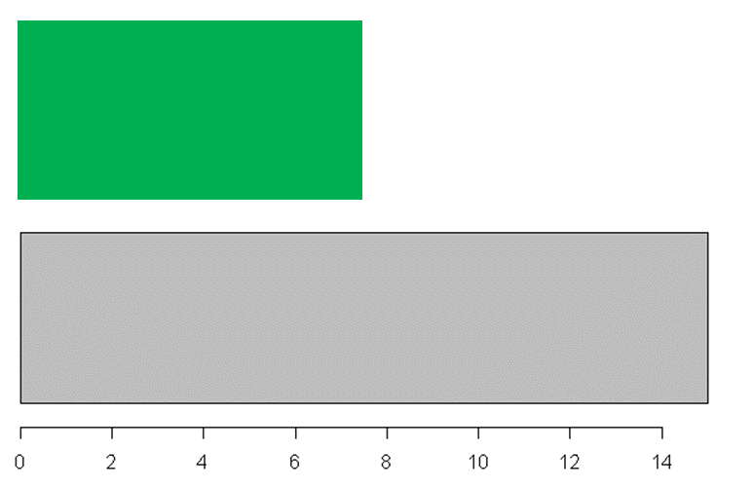
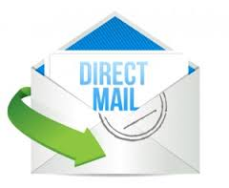
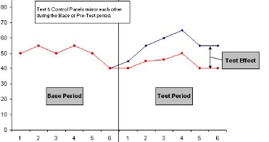

Mu Sigma’s framework looked at over 800 different dimensions (Inc. digital) and leveraged a strong, micro-segmentation approach
Product Recommendation – NLP Model
Feature Extraction
Using Hypothesis and Factor Buckets in the muPDNA to identify features that need to be extracted
Behavioral Segments
Creating Behavioral Segment by leveraging the significant list of variables
Pattern Detection
Based on data exploration and hypothesis in the muPDNA, we have identified distinct patterns with significant population in the data
Product Back-testing
For each of these patterns, identified adoption rate across different product lines
CHK ?
SAV ?
CKP ?
CCL ?
PL ?
HELOC ?
Test & Learn
Setup Test & Control sets to roll-out offers and establish feedback loop which goes in as an input to the framework

Slide 4
Multiple supervised and unsupervised testing helped us narrow down to the most significant variables for segmentation
Product Recommendation – Variable Reduction Techniques Complexity
1200 variables
Univariate Logistic Regression
Check which variables from the ADS are independently significant in explaining variance in Debit | Credit Purchase
217 variables
Remove on Extent of Data Capture
Remove Variables (Only Retail Data Related Variables) that capture non-zero values for less than 50% of the data
83 variables
Principal Component Analysis
PCA to identify Principal Components that explain the maximum variance in the data
40 variables
Correlation
Remove Correlated Pairs based on Heuristics & variation captured in each of the variables
27 variables
Multi-Collinearity
Multi-variate testing to remove effect of Multi-Collinearity using Variance Inflation Factor (VIF)
24 variables
Multi-Logit
Multivariate Logistic Regression to identify combination of variables that are significant in demarcating Credit | Debit Need
13 variables
Note: a) These 13 variables that remain have been used across iterations to create segments to identify Need States

Slide 5
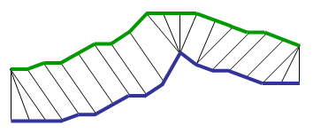
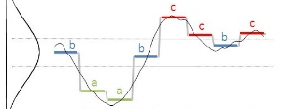
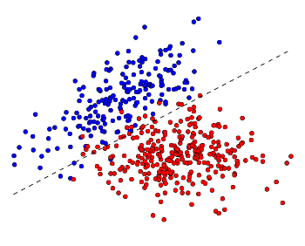
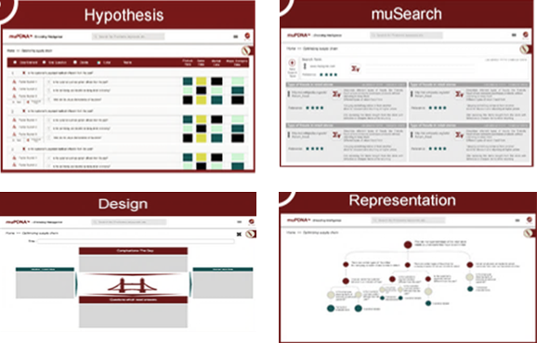
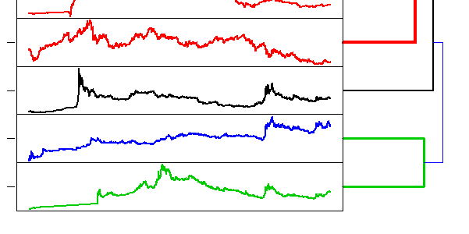
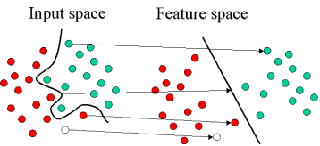
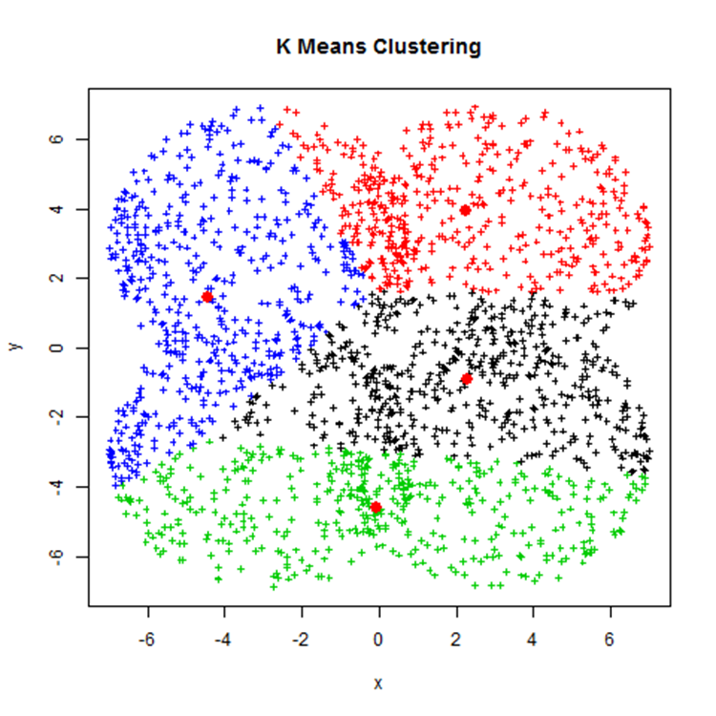
Strong discover-and-learn synergies (Using muPDNA & Machine Learning) where leveraged to build highly rich need state patterns
Product Recommendation – Discovery + Hypothesis
Pattern Development Cycle
Discover
Relevant States
Hypothesize
Unsupervised Approaches
Anomaly Detection
Unsupervised Growth
Threshold Identification
SAX/ DTW
Business Inputs
Dynamic Time Warping
SAX Patterns
muPDNA
Cross Industry Experience
Time Series Clustering
K-means + LDA
K-means + SVM
K-means + SAX

Slide 6


The engine forms the core trigger for the business’ Customer Experience framework and provides inputs to multiple levers
Product Recommendation – Deployment & Integration
1
5
7
Need State Engine
EMOB Engine
Landing Page Optimizer
2
Banner/ Targeting Design Engine
6
CX Cockpit
7
3
Image Processing Engine
Trigger-based Marketing
8
4
Chat Optimization Engine
Feedback/ Active learning Engine
9
9
Digital Listening Engine
Internal Site Search Optimizer

Slide 7
The Next Best Offer framework holds the potential to yield a 3x incremental adoption rate
Product Recommendation – Results and Impact
Behaviors Defining the Need State
Need State Behavior
% Hits on PL Pages
Customers belonging to one of three higher value wealth segments
Fluctuation of transactional activity over time forces customers to traverse across wealth segments in the last six month
Overall balance decreased by over 20% in the last 2-3 months
Overall signs of customers struggling with low balance
Customers have shown presence in digital platform, with inclination shown for credit lines
.
.
.
Illustrative
Product Page Hits
Better Regulation of money through debt consolidation
Credit Amount
Debit Amount
Checking Balance
Overall Balance
Suggested Service Line: Personal Loan
Insights & Recommendations
The framework leverages the micro-segments in conjunction with customers’ digital footprints and delivers recommendations based on their need states
All these recommendations can result in up to 3x incremental adoption rate (subject to conversion rates)
combination of hypotheses and discovery driven approach has been leveraged to extract patterns which indicate a need state footprint
Out of the 2.2 MM customer base, 7% are eligible with 53% of them with a digital footprint
~$100MM impact can be realized due to the correct targeting of customers

